Slide 1
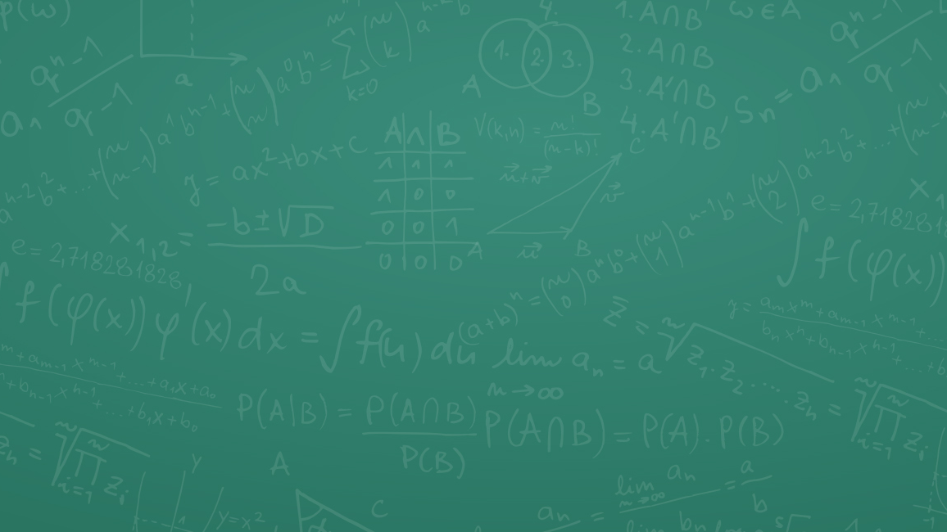
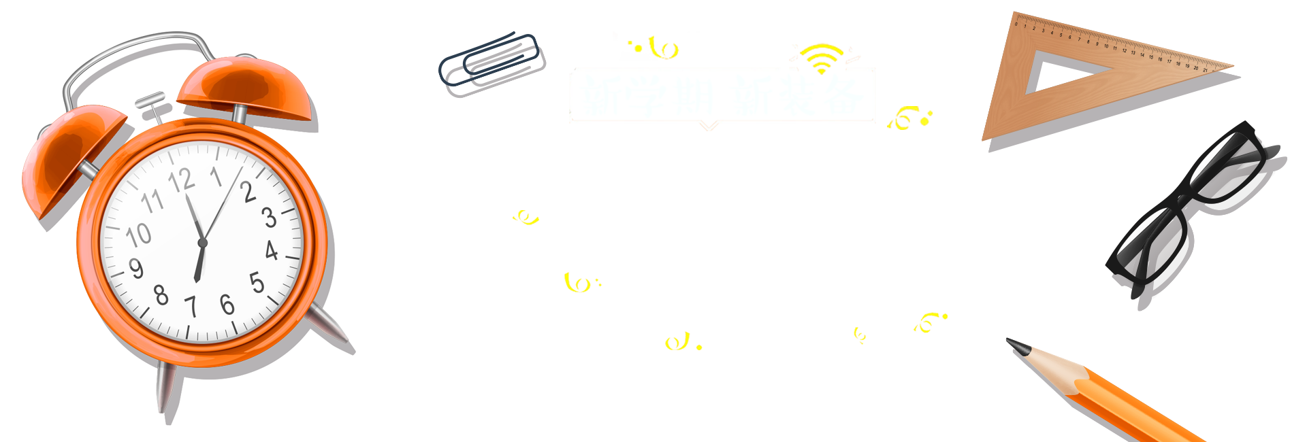

Water Jug Problem

Slide 2
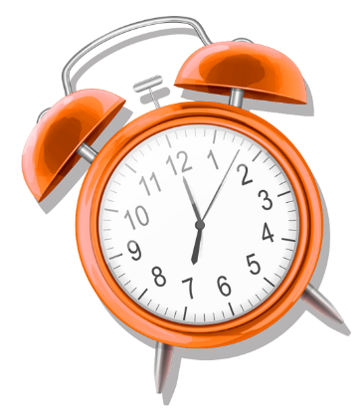
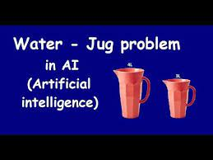
The Problem
A Water Jug Problem: You are given two jugs, a 4-gallon one and a 3-gallon one, a pump which has unlimited water which you can use to fill the jug, and
the ground on which water may be poured. Neither jug has any measuring markings on it. How can you get exactly 2 gallons of water in the 4-gallon jug?

Slide 3
State Representaion and Initial State
State
Representaion
Initial State
We will represent a state of the problem as a tuple (x, y) where x represents the amount of water in the 4-gallon jug and y represents the amount of water in the 3-gallon jug. Note 0 ≤ x ≤ 4, and 0 ≤ y ≤ 3.
Our initial state: (0,0)

Slide 4
Goal Predicate and Operators
Goal Predicates
state = (2,y) where 0 ≤ y ≤ 3.
Operators
We must define a set of operators that will take us from one state to another:

Slide 5
Operators
1 | Fill 4-gal jug | (x,y) x < 4 | (4,y)
2 | Fill 3-gal jug | (x,y) y < 3 | (x,3)
3 | Empty 4-gal jug on ground | (x,y) x > 0 | (0,y)
4 | Empty 3-gal jug on ground | (x,y) y > 0 | (x,0)
5 | Pour water from 3-gal jug to fill 4-gal jug | (x,y) 0 < x+y ≥ 4 and y > 0 | (4, y - (4 - x))
6 | Pour water from 4-gal jug to fill 3-gal jug | (x,y) 0 < x+y ≥ 3 and x > 0 | (x - (3-y), 3)
7 | Pour all of water from 3-gal jug to fill 4-gal jug | (x,y) 0 < x+y ≤ 4 and y ≥ 0 | (x+y, 0)
8 | Pour all of water from 4-gal jug to fill 3-gal jug | (x,y) 0 < x+y ≤ 3 and x ≥ 0 | (0, x+y)

Slide 6
Solution?

Slide 7
Through Graph Search, the following Solution is found:
Gals in 4-ga jug | Gals in 3-gal jug | Rule Applied
0 | 0 | 1. Fill 4
4 | 0 | 6. Pour 4 into 3 to fill
1 | 3 | 4. Empty 3
1 | 0 | 8. Pour all of 4 into 3
0 | 1 | 1. Fill 4
4 | 1 | 6. Por into 3
2 | 3

Slide 8
Thank you for your time
By: ANISH
Class: CSE 4B
Roll no: 2K19CSUN01069

